Slide 1
LUCIFER
a potentially background-free approach to the search for 0νββ
Claudia Nones
CSNSM/CNRS-Orsay
NOW2010 – September 4th - 11th, 2010 – Conca Specchiulla, Italy

Slide 2
Outline
Background and sensitivity in the search for 0νββ
The LUCIFER project
The R&D activities @ LNGS and @ CSNSM-Orsay
Perspectives & Conclusions

Slide 3
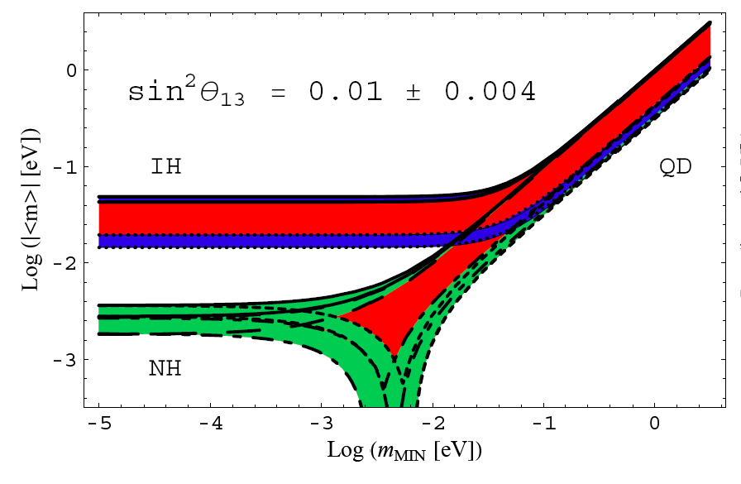
The size of the challenge
100 – 1000 counts/ y ton
⁷⁶Ge claim
50 meV
1 – 10 counts/ y ton
15 meV
0.1 – 1 counts/ y ton
Goal: b= 10⁻³ – 10⁻⁴ c/keV/kg/y with a high energy resolution detector

Slide 4
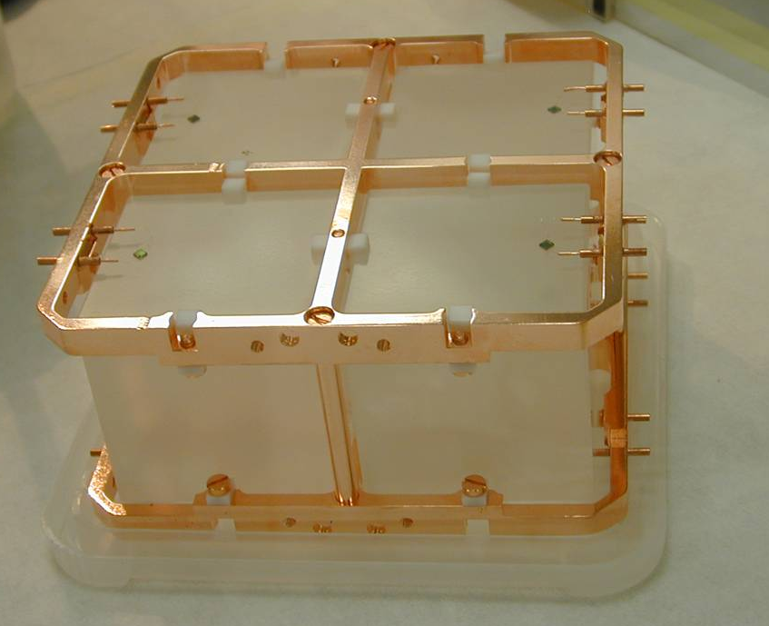
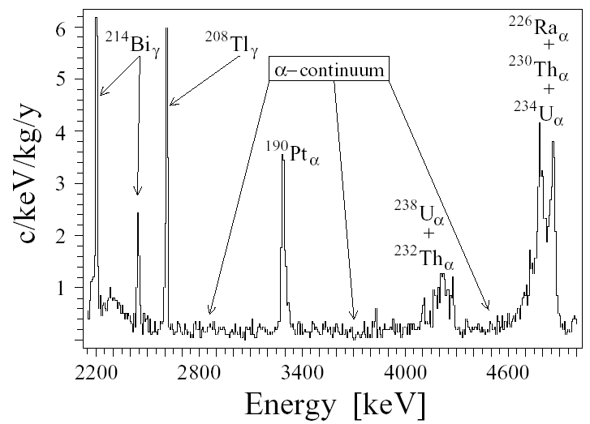
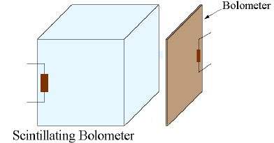
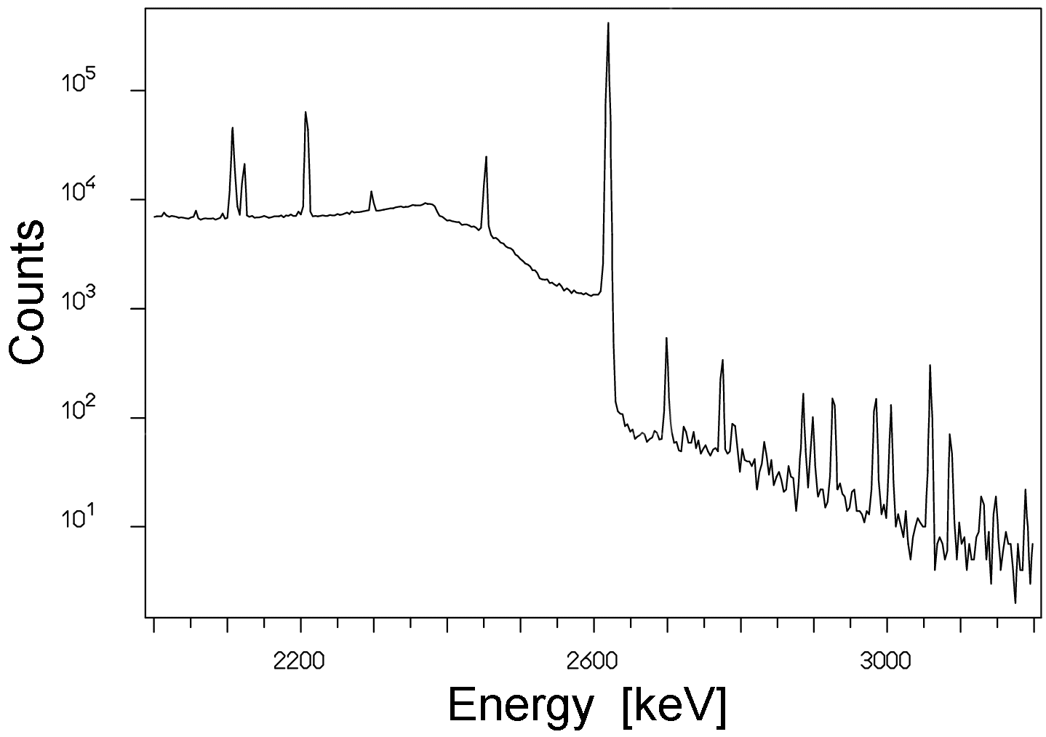
The LUCIFER recipe
How to approach a 0 background experiment:
1
High energy resolution
(no background from 2νββ)
⁷⁶Ge
¹³⁰Te
¹¹⁶Cd
¹⁰⁰Mo
2
Make irrelevant the γ background
⁸²Se
Environmental “underground” Background:
²³⁸U and ²³²Th trace contaminations
3
Discrimination between α and β particles
Bolometers
CUORICINO background
Energy-degraded α above 2615 keV
A bolometer with embedded a high Q-value 0νββ isotope that also scintillates
Isotope with a high Q value

Slide 5
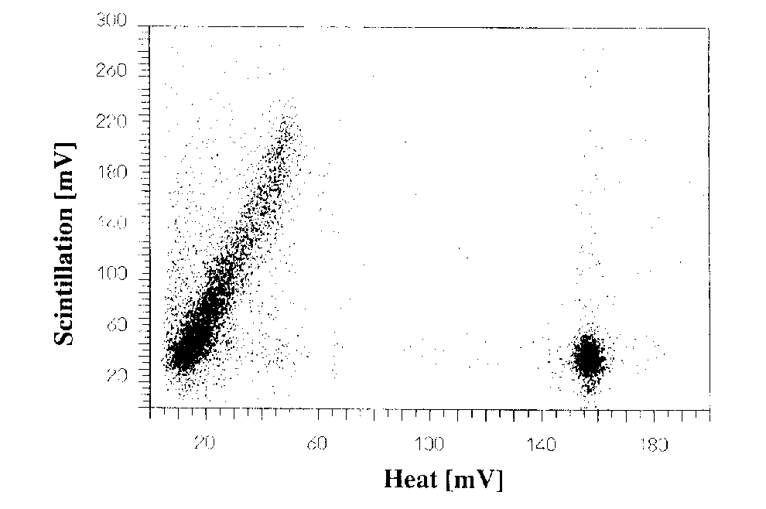
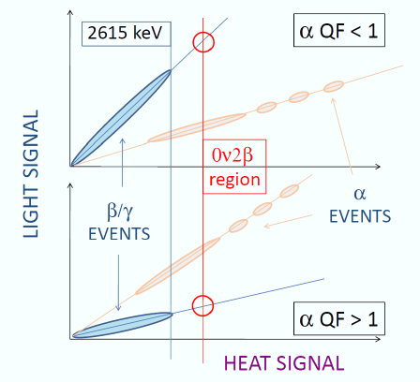
Double read-out bolometers: heat + light
Scintillating crystal under test
Reflecting foil
A device able to measure simultaneously the phonon (heat) excitations and the photon (scintillation) excitations generated in a crystal by the same nuclear event can efficiently discriminate alphas from betas / gammas.
V_{heat}
Original idea
Milano group
mid 1990’s
CaF₂ scintillating bolometer
Ge disk
The experimental basis for LUCIFER is the R&D activity performed by Stefano Pirro at LNGS, in the framework of the programs:
BOLUX, funded by INFN – CSN5
ILIAS-IDEA funded by the European Commission (WP2-P2)
beta
V_{light}
alpha
Copper frame
Alphas emit a different amount of light with respect to beta/gamma of the same energy (normally lower → a QF < 1, but not in all cases).
A scatter plot light vs. heat separates alphas from betas / gammas.

Slide 6
LUCIFER
Low-background Underground Cryogenics Installation For Elusive Rates
Principal Investigator: Fernando Ferroni
Co-Investigator : Andrea Giuliani
ERC-2009-AdG 247115
Double Beta Decay pilot project
based on scintillating bolometers

Slide 7
Candidate isotopes in scintillating bolometers
Nucleus I. A. Q-value Materials successfully tested as bolometers
[%] [keV] in crystalline form
⁷⁶Ge 7.8 2039 Ge
¹³⁶Xe 8.9 2479 NONE
¹³⁰Te 33.8 2527 TeO₂
¹¹⁶Cd 7.5 2802 CdWO₄, CdMoO₄
⁸²Se 9.2 2995 ZnSe
¹⁰⁰Mo 9.6 3034 PbMoO₄, CaMoO₄, SrMoO₄, CdMoO₄, SrMoO_{4,} ZnMoO_{4,} Li₂MoO₄, MgMoO₄
⁹⁶Zr 2.8 3350 ZrO₂
¹⁵⁰Nd 5.6 3367 NONE → many attempts
⁴⁸Ca 0.187 4270 CaF₂, CaMoO₄
Underlined compounds are good scintillators
Four high Q-value candidates (¹¹⁶Cd – ¹⁰⁰Mo – ⁸²Se – ⁴⁸Ca)
can be studied as scintillating bolometers

Slide 8
The choice of the isotope
There are 3 main candidates
¹¹³Cd beta emitter
¹¹³Cd high neutron cross-section
Transition energy does not indicate a preference
 | Q-value [keV] | Useful material | LY [keV/MeV] | QF (α/β) | Enrichment [€/g]
CdWO₄ | 2809 | 32% | 34 | 0.19 | > 150-200
ZnMoO₄ | 3034 | 44% | 1.4 | 0.16 | 50-80
ZnSe | 2995 | 56% | 7.4 | 4.2 | 50-80
Pros
Cons
Active isotope: ⁸²Se
Decay: ⁸²Se -> ⁸²Kr + 2e⁻
Q-Value: 2995 keV
Abundance: 9%
The baseline: ZnSe

Slide 9
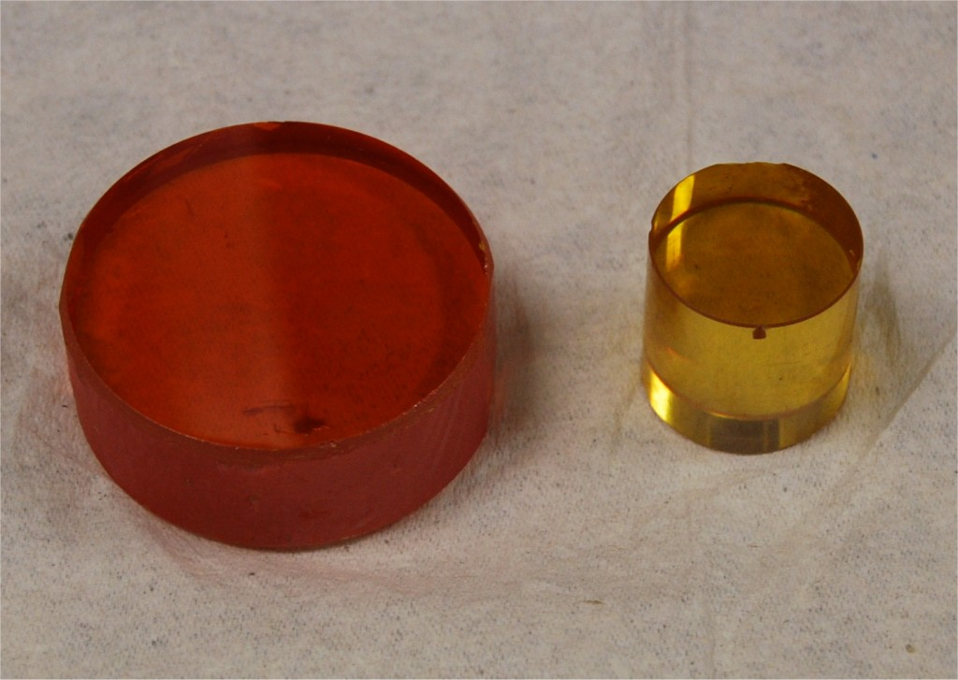
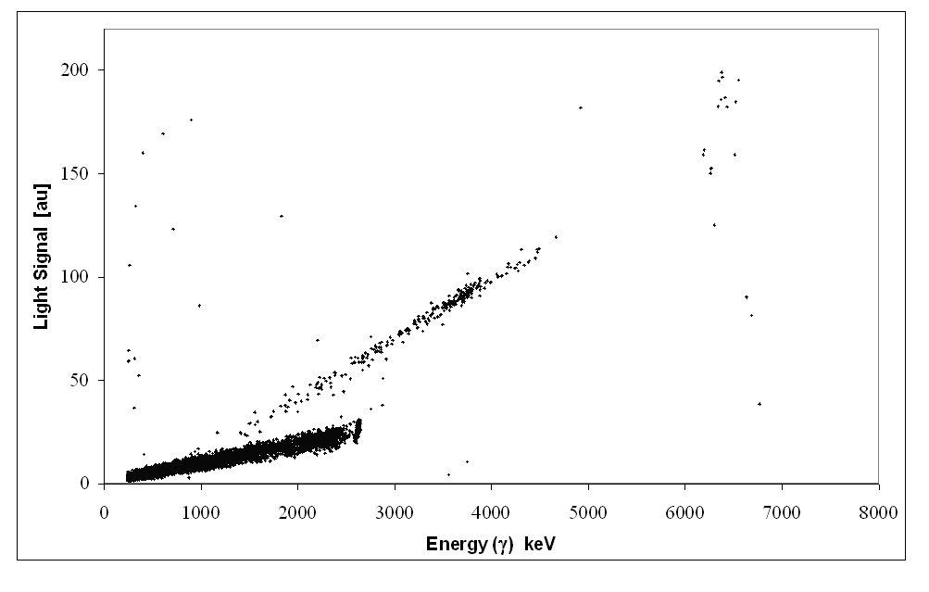
Results @ LNGS (1)
QF > 1: alphas give more light than gammas
→ risk of leakage in the beta/gamma region?
≈ 4 cm,
1.7 cm height,
120 g
φ=2 cm, 3 cm height, 39 g
Just an example
Q-value of ⁸²Se
2615 keV:
the end of γ radioactivity
α
Background free area
β/γ

Slide 10
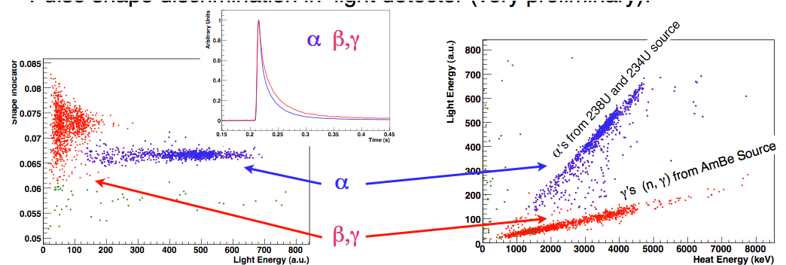
Results @ LNGS (2)
Spring 2010
Pulse shape discrimination in light detector
(very preliminary)
Final surprise:
pulse shape discrimination in the heat signal
There are no enough data to conclude that pulse shape discrimination is sufficient to reject alphas at the desired level, but it is surely crucial to investigate this opportunity.

Slide 11
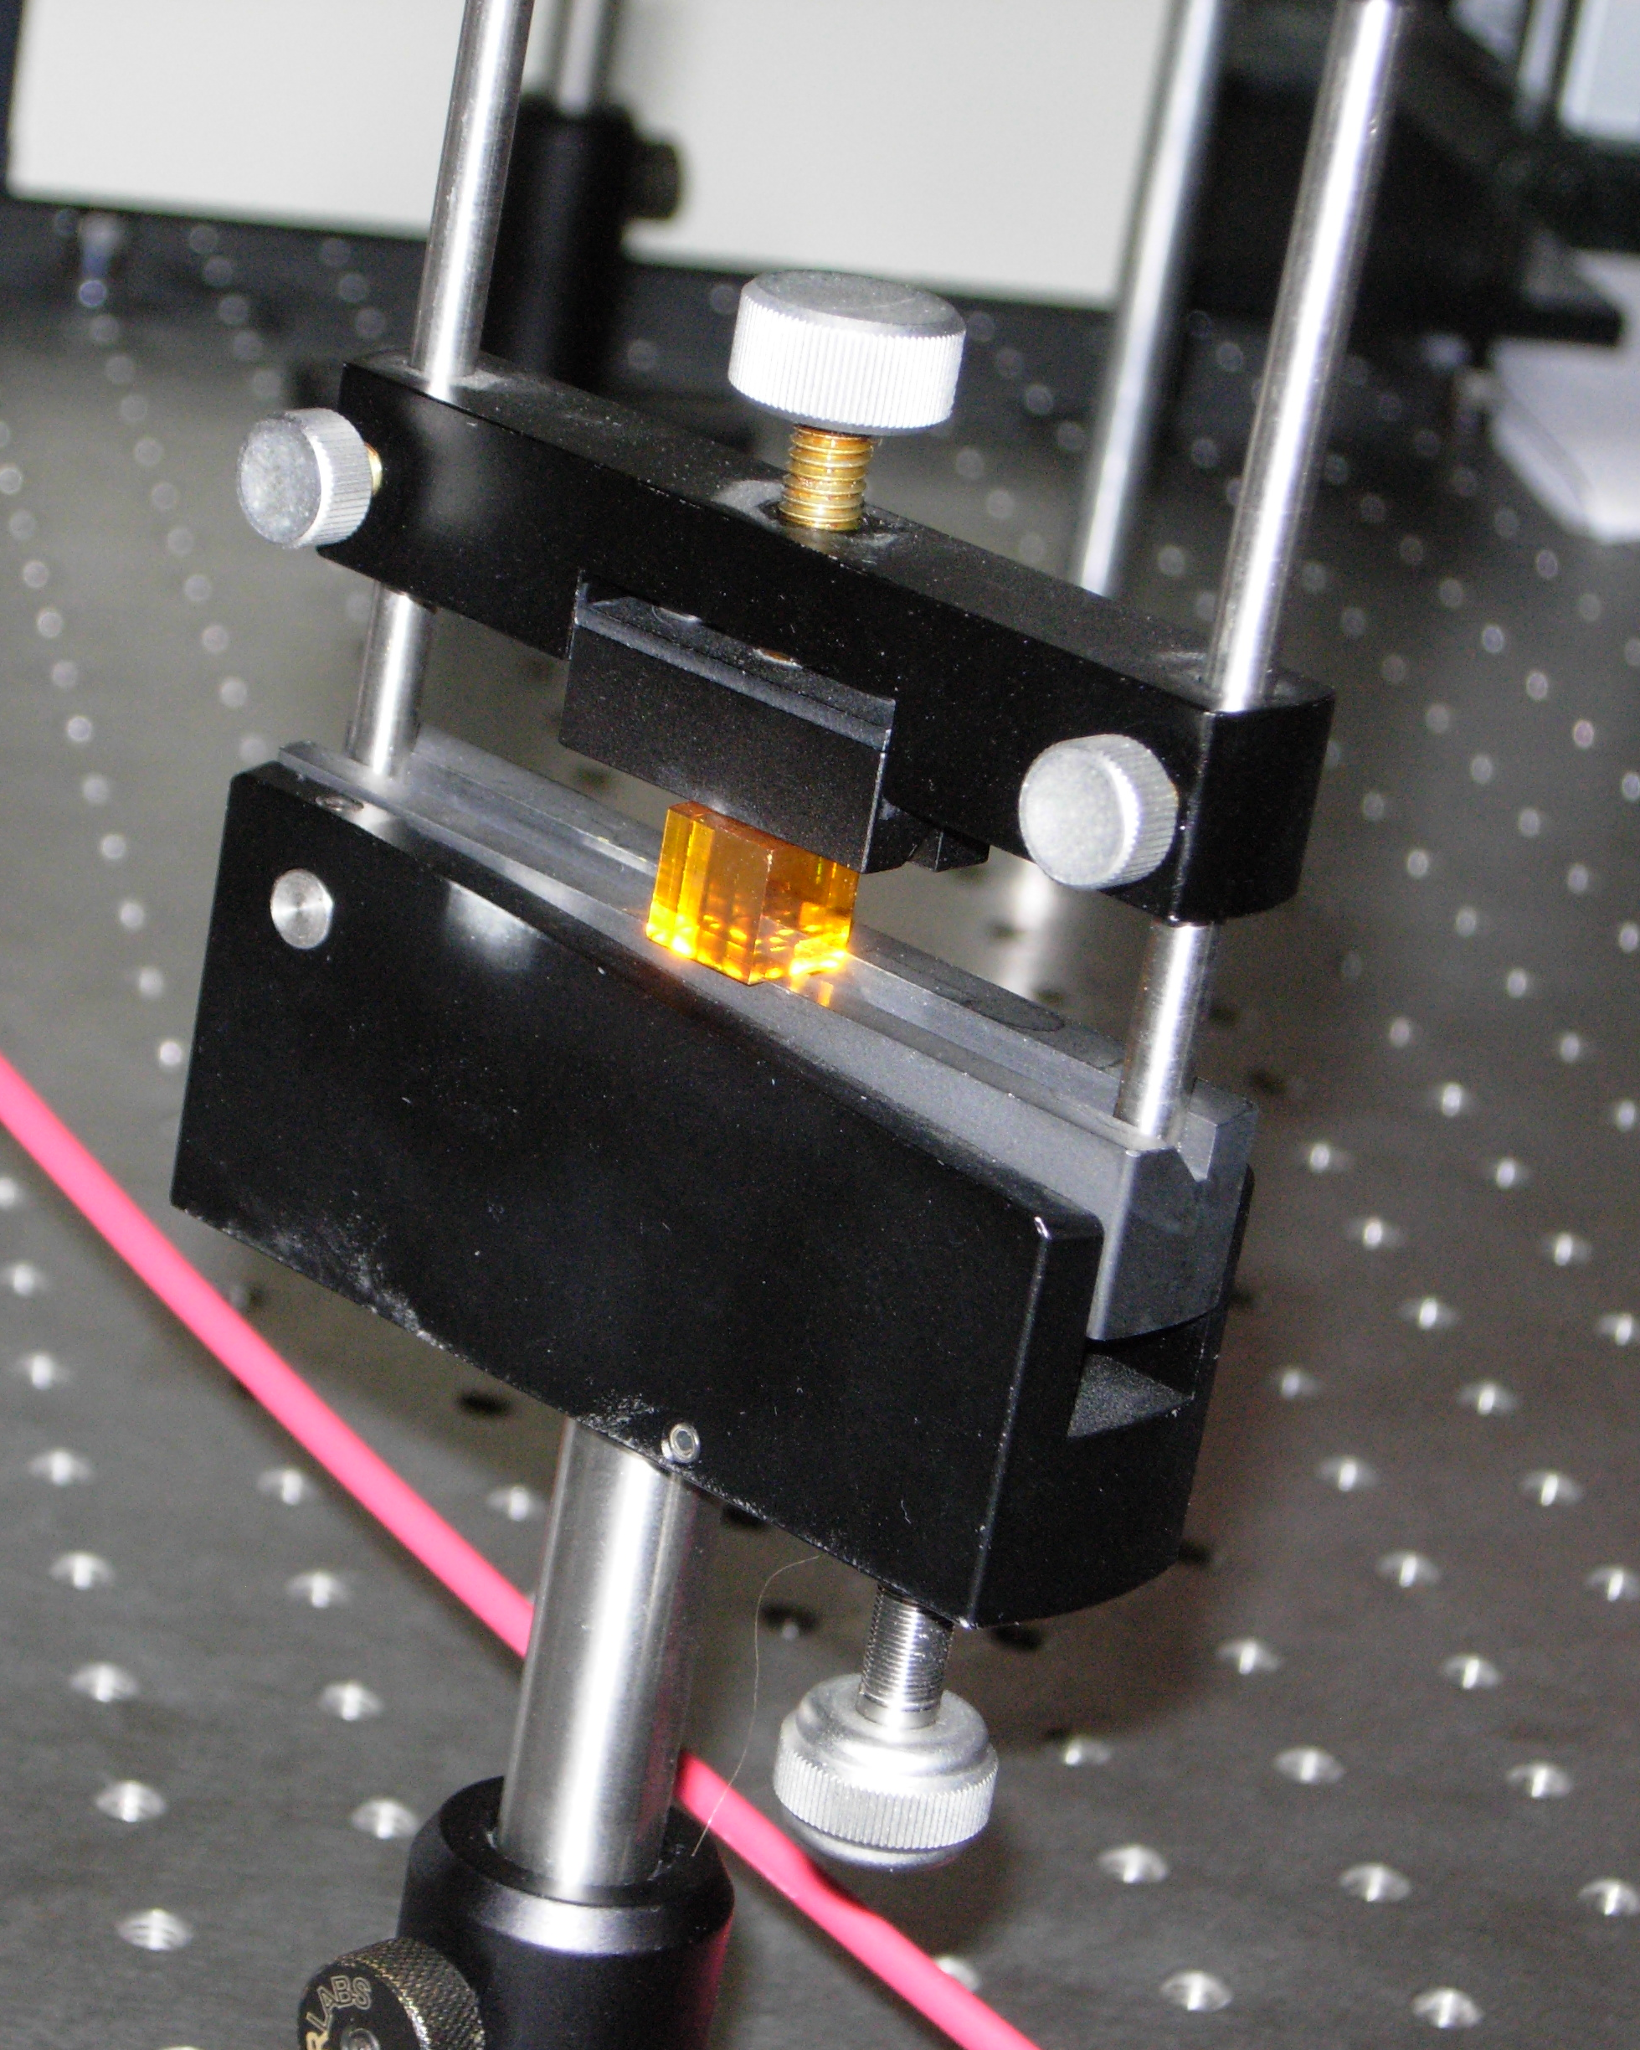
ZnSe optical properties
From preliminary measurements performed on ZnSe bolometric and scintillation characteristics:
very promising results on the amplitude of scintillation signal
very promising capability to discriminate between α and β particles
Preliminary
Nevertheless
Quenching factor > 1
Quite large spread of characteristics
(even among samples delivered by the same producer)
Study of optical properties (optical trasmission and luminescence)
Study of the effect of impurities and local defect on the optical properties of ZnSe crystals
Sample: 1x1x1 cm³ - ZnSe

Slide 12
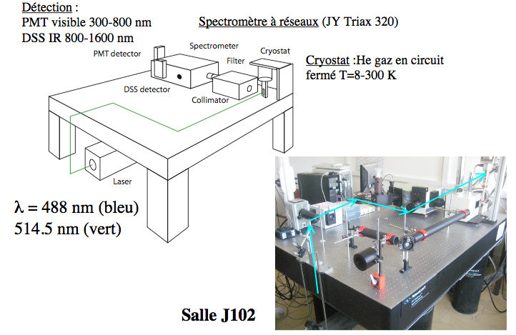
Study of ZnSe optical properties @ CSNSM
Courtesy of O. Plantevin

Slide 13
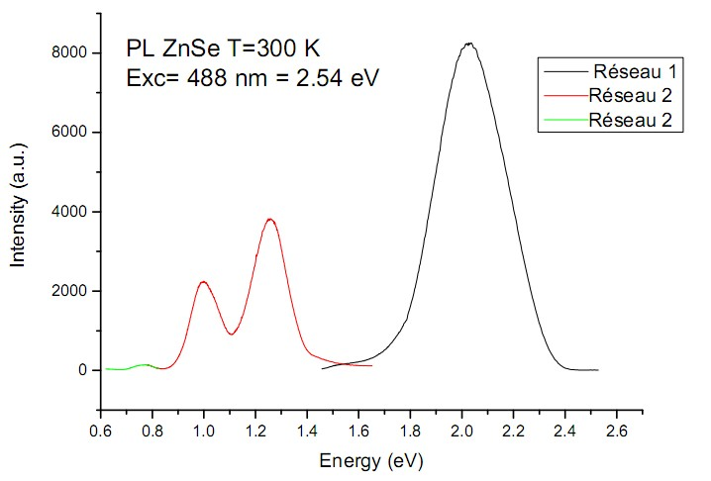
Photo-luminescence measurements @ CSNSM
A
Preliminary
July 2010
B
C
D
emission band | E [eV] | λ [nm]
A | 2.02 | 613.86
B | 1.27 | 976.38
C | 0.95 | 1305.3
D | 0.76 | 1631.6
Next steps:
photoluminescence @ low temperatures

Slide 14
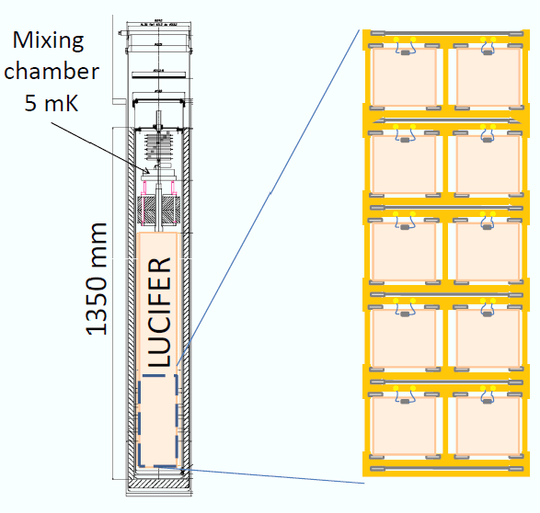
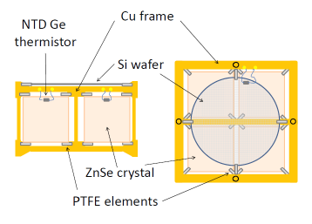
LUCIFER detector structure
Possible location:
ex-Cuoricino cryostat @ LNGS
Preliminary
Tower:
12 single modules
Single module:
4 ZnSe crystals
and 1 light detector
LUCIFER is a demonstrator…

Slide 15
The physics reach
…but has a remarkable sensitivity by itself
From the LUCIFER proposal:
Crystal | Isotope weight | Useful material | Half Life limit (10²⁶y) | Sensitivity* to m_{ee} (meV)
CdWO₄ | ¹¹⁶Cd 15.1 kg | 32% | 1.15 | 65-80
ZnMoO₄ | ¹⁰⁰Mo 11.3 kg | 44% | 1.27 | 67-73
ZnSe [baseline] | ⁸²Se 17.6 kg | 56% | 2.31 | 52-65
ZnSe [option 1] | ⁸²Se 20.5 kg | 56% | 2.59 | 49-61
ZnSe [option 2] | ⁸²Se 27.8 kg | 56% | 3.20 | 44-55
* The 1σ sensitivity is calculated with the Feldman Cousins approach for 5 y running and a background index dΓ_{b}/dE = 10⁻³ c/keV/Kg/y. The matrix elements come from the two most recent QRPA calculations [ME08]; the energy window is taken as 5 keV, compatible with the resolution achieved in TeO₂ macrobolometers and in scintillating-bolometer R&D.
More realistic evaluation: 10 kg of isotope
~100 meV as <m_{ββ}> sensitivity
Optimistic evaluation, assuming full success for several difficult tasks:
negotiate a good contract for enrichment → Zelenogorsk (Russia), URENCO (NL)
get radiopure and chemically pure isotope after enrichment
efficient crystallization → Institute for Single Crystals, Kharkov, Ukraina
optimize bolometric performance of ZnSe crystals

Slide 16
LUCIFER next steps
Procurement of the enriched material
NEXT STEPS
Cristal growth optimization
Optimization of light detectors
Optimization of ZnSe scintillating bolometers
LUCIFER
Kick-off
Data taking
First physics results
LUCIFER Assembly
2014

Slide 17
Conclusions & Perspectives
A 0 background approach is mandatory to reach sensitivities useful to scan completely the inverted hierarchy region.
Double read-out detectors (heat+light) are a powerful tool.
LUCIFER is the first full demonstrator of this technique.
An intense R&D programme is going on.
LUCIFER data taking: 2014.

Slide 18
BACK-UP

Slide 19
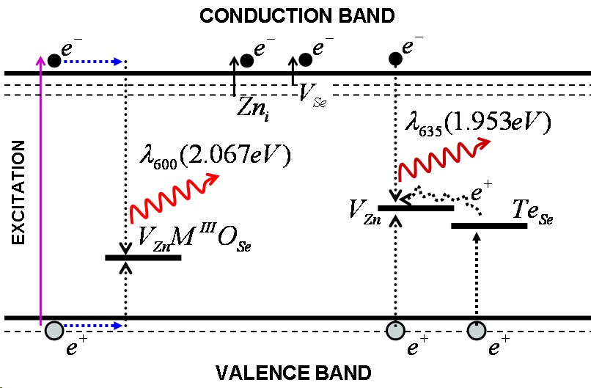
N. Starzhinskiy et al, IEEE Trans. Nucl. Science, 55, 1542 (2008)

